Slide 1
VIETNAM’S RAW CASHEW IMPORT 2016,
RAW CASHEW QUALITY CONTROL SOLUTIONS,
VIETNAM-CAMBODIA 2017 SEASON FORECAST
Singapore, Feb. 09th, 2017
Speaker: Mr. Cao Thuc Uy
Director – CAO PHAT CO., LTD

Slide 2
I. VIETNAM’S RAW CASHEW IMPORT 2016 1. Quantity, turnover, average price 2. Import Markets 3. Top Importers 4. Quality

Slide 3
1. QUANTITY, TURNOVER AND AVERAGE PRICE
AVERAGE PRICE OF IMPORTED RAW CASHEW IN 2016: 1566 USD/MT CFR
MONTH | IMPORT QUANTITY (Mt) | IMPORT TURNOVER (USD) | AVERAGE IMPORT PRICE (USD/MT)
1 | 34,005 | 55,017,773 | 1,618
2 | 20,913 | 32,943,526 | 1,575
3 | 116,668 | 181,703,416 | 1,557
4 | 35,334 | 53,564,510 | 1,516
5 | 100,931 | 143,771,519 | 1,424
6 | 159,999 | 231,901,012 | 1,449
7 | 165,858 | 246,933,422 | 1,489
8 | 138,812 | 213,657,386 | 1,539
9 | 94,989 | 148,724,042 | 1,566
10 | 94,736 | 158,345,965 | 1,671
11 | 52,799 | 98,255,120 | 1,861
12 | 125,032 | 221,355,543 | 1,770
TOTAL | 1,140,077 | 1,786,173,233
(Source: VINACAS)

Slide 4
2. IMPORT MARKET
(Source: VINACAS)
EXPORT COUNTRY | QUANTITY (MT) | SHARE (%)
Ivory Coast | 447,495 | 39.25
Nigeria | 131,806 | 11.56
Ghana | 115,640 | 10.14
Tanzania | 88,003 | 7.72
Indonesia | 84,889 | 7.45
Cambodia | 83,370 | 7.31
Guinea | 73,143 | 6.42
Guinea Bissau | 35,322 | 3.10
Benin | 22,178 | 1.95
Togo | 13,729 | 1.20
Burkina Faso | 12,900 | 1.13
Senegal | 10,607 | 0.93
Mozambique | 6,207 | 0.54
Gambia | 5,032 | 0.44
Others | 9,756 | 0.87
Total | 1,140,077 | 100

Slide 5
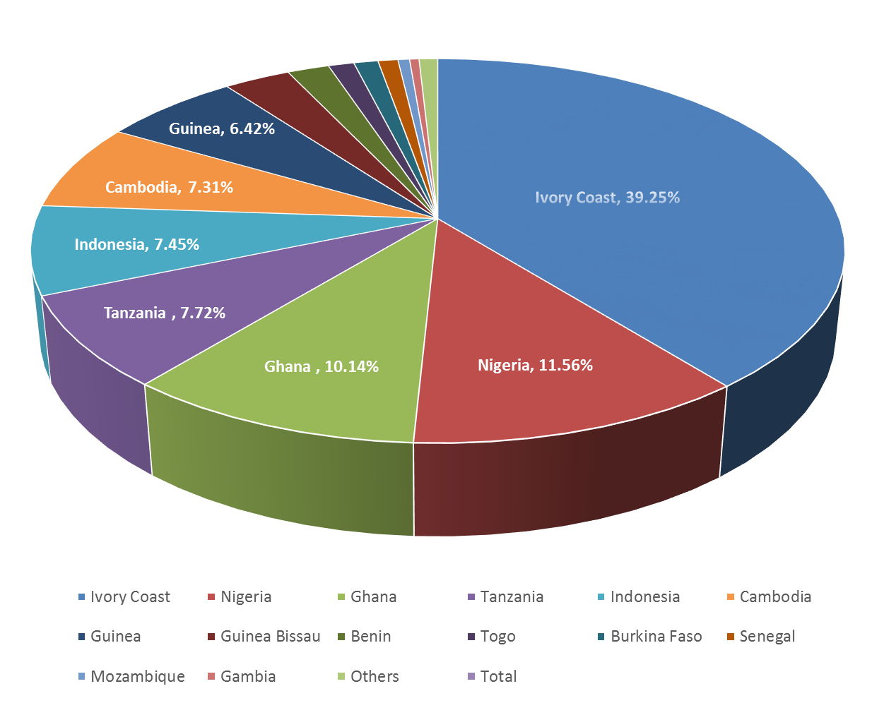

( Source: VINACAS )

Slide 6
3. TOP IMPORTERS
MONTH | NUMBER OF IMPORTERS | IMPORT QUANTITY (Mt) |  | TOP TEN IMPORTERS (* VINACAS members)
 |  | Max | Min
1 | 80 | 2,741 | 16 | Olam VN, Minh Huy, CAO PHAT, Tanimex-LA, Lafooco, Thanh Hien,My Le, Hoang Son 1, Phuc An, Duy Duc
2 | 64 | 1,754 | 18 | CAO PHAT, Olam VN, Minh Huy, Lafooco, Thanh Thom, Rals VN, Dai An, An Dien, Nam Ha, Tu Hai
3 | 143 | 5,000 | 16 | Olam VN, CAO PHAT, Minh Huy, Hung Phu, Hoang Son 1, Thanh Hien, Lafooco, Quang Son, My Le, Tanimex-LA
4 | 59 | 3,100 | 17 | Da Kao , Rals VN, Huynh Minh, Olam VN, My Le, Long Duc, Phuc An, Ladco, Nam Ha, Bimico
5 | 120 | 9,741 | 26 | Olam VN, Hoang Son 1, Huynh Minh, Da Kao, Tan Hoa, Bimico, Tanimex-LA, Rals VN, CAO PHAT, Ladocashews
6 | 141 | 8,030 | 17 | Hoang Son 1, Da Kao, Hunh Minh, Olam VN, Tan Hoa, Tanimex-LA, Thao Nguyen, CAO PHAT , Rals VN, Bimico

Slide 7
7 | 147 | 12,143 | 28 | Olam VN, Hoang Son 1, CAO PHAT, Da Kao , Rals VN, Tan Hoa, Kieu Loan, Tanimex-LA, Hoang Ha BP, BIMICO
8 | 138 | 13,076 | 25 | Olam VN, Long Son, CAO PHAT, Tan Hoa, Hoang Son 1, Minh Huy, Da Kao, Kieu Loan, Tu Hai, Rals VN
9 | 122 | 7,277 | 0.001 | Long Son, Olam VN, Rals VN,Tan Hoa, Tu Hai, Minh Huy, BIMICO, My Le, Phuc An, Valency VN
10 | 119 | 12,392 | 0.006 | Long Son, Olam VN, Rals VN, C&N (Tanimex-LA),Tan Hoa, Intimex, Da Kao, Thao Nguyen, CAO PHAT , Thai Gia Son
11 | 114 | 3,367 | 15 | My Le, Phu Thuy, Olam VN, Phuc An, Long Son, Hoang Son 1, Duy Duc, Minh Huy, Da Kao, Valency VN
12 | 120 | 13,097 | 0.0035 | Tan Hoa, Rals VN, Da Kao, CAO PHAT , C&N (TanimexLA), Bimico, Olam VN, Thai Gia Son, Ladco, Long Son
(Source: VINACAS)

Slide 8
4. QUALITY IMPORT QUALITY COMPARATION BETWEEN 2015 AND 2016
EXPORT COUNTRY | OUT TURN |  | MOISTURE |  | FOREIGN MATTER
 | ( LB/80KGS ) |  | ( % ) |  | ( % )
 | 2015 | 2016 | 2015 | 2016 | 2015 | 2016
COAST IVORY | 45 – 49 | 39 - 48 | 9 – 10 | 9 – 12 | 0.2 – 0.3 | 0.2 – 0.3
CAMBODIA | 49 | 51 | 16 (fresh ) | 16 (fresh) | 0.5 | 0.5
NIGERIA | 44 – 50 | 33 – 48 | 9 – 10 | 9 – 12 | 0.2 – 0.3 | 0.2 – 0.3
GHANA | 45 - 49 | 45 -49 | 9 – 10 | 9 – 10 | 0.2 – 0.3 | 0.1 – 0.2
GUINE BISSAU | 50 – 54 | 49 – 53 | 9 – 10 | 9 – 11 | 0.2 – 0.3 | 0.1 – 0.2
TAZANIA | 51 – 54 | - | 9 – 10 | - | 0.2 – 0.3 | -
INDONESIA | 49 - 54 | 50 - 54 | 9 – 10.5 | 9 - 10 | 0.1 – 0.3 | 0.1 - 0.2
(Source: Vinacontrol)

Slide 9
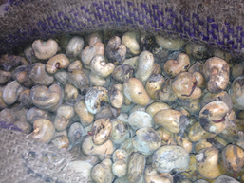
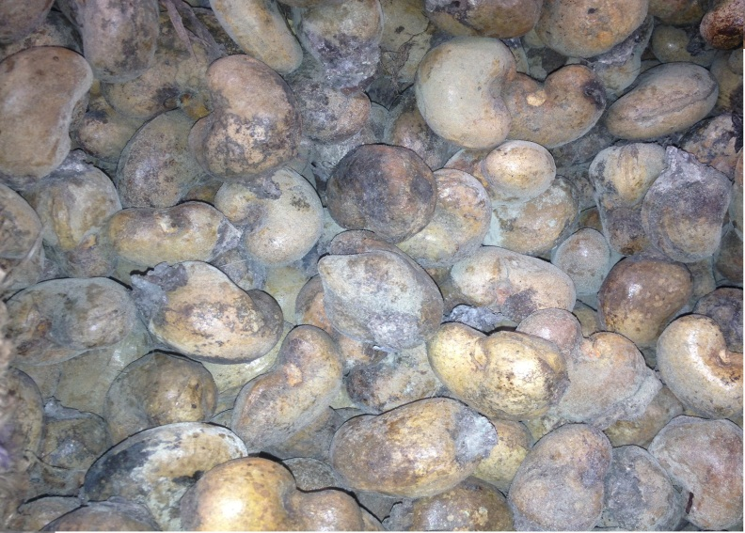
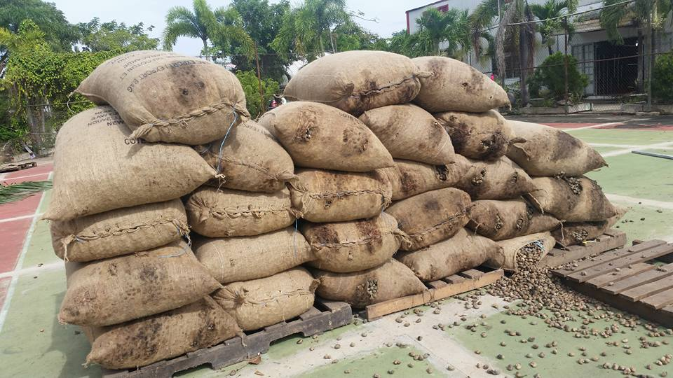
Light mold

Slide 10
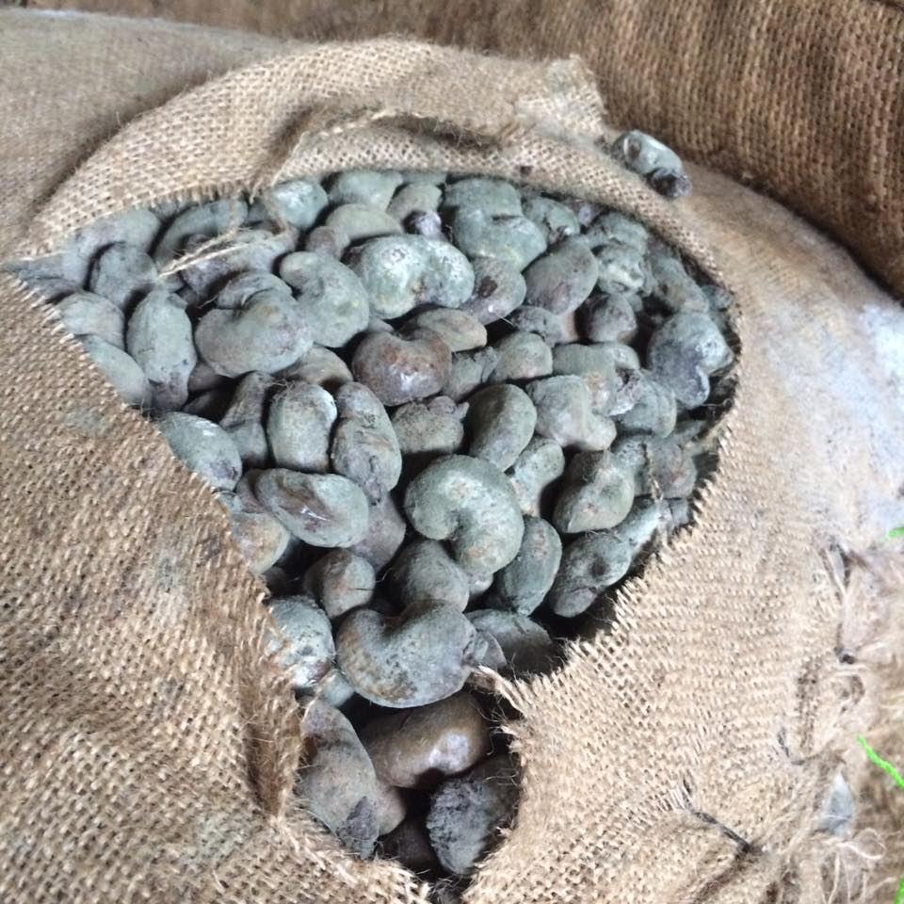
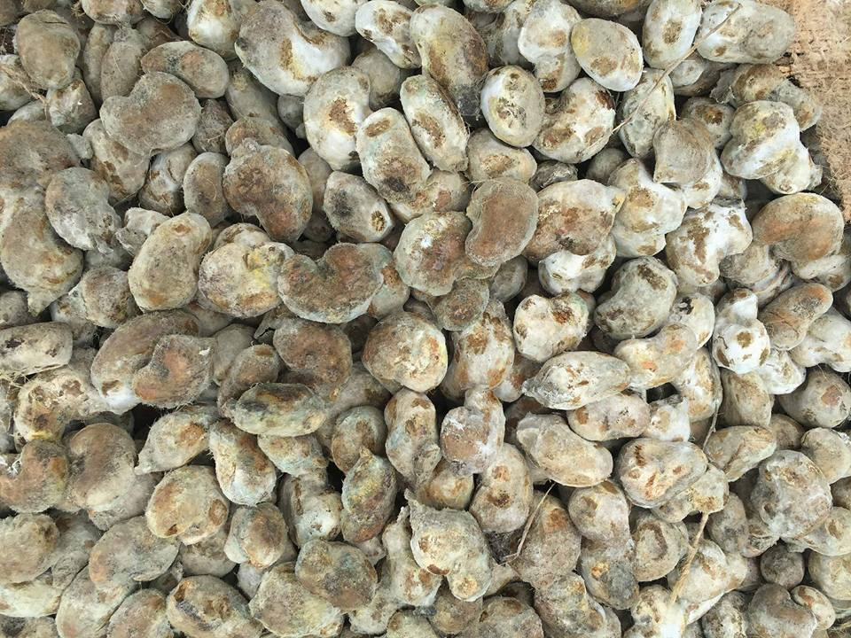
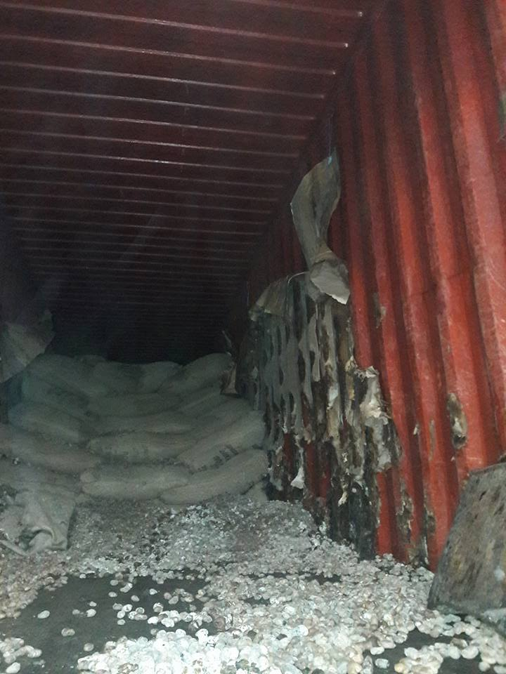
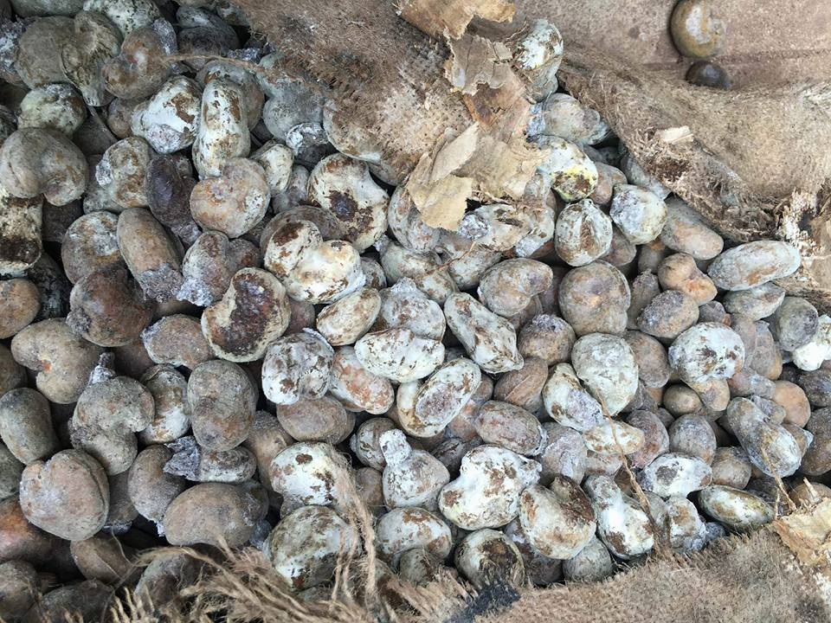
Heavy mold

Slide 11
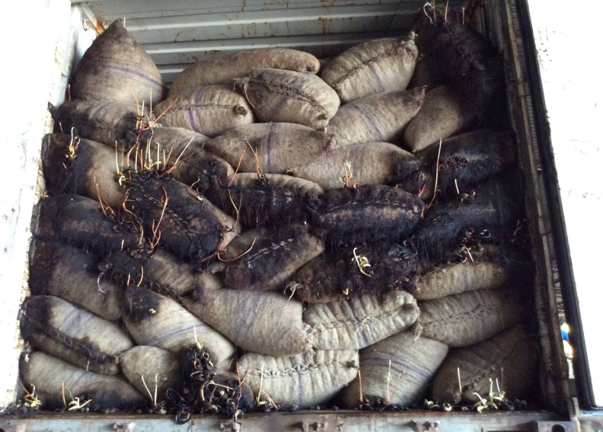
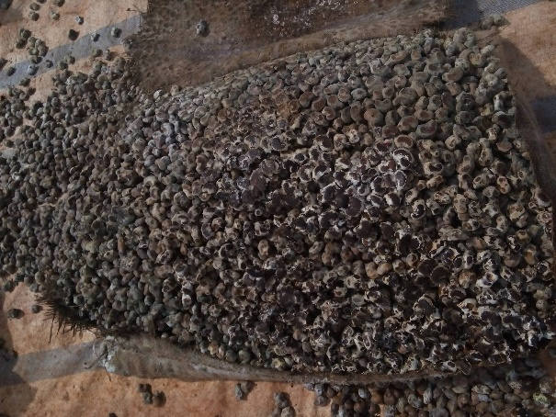
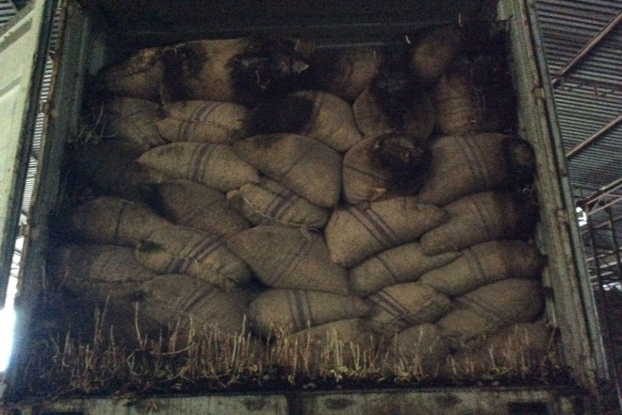

Sprout, damaged

Slide 12
II. HOW TO CONTROL QUALITY MORE STRICTLY IN 2017 SEASON 1. Moisture Control Raw cashew must be well dried to get moisture below 10% before stuffing 2. Storage Control Raw cashew must be stored in good condition from harvest to export

Slide 13

III. VIETNAM-CAMBODIA 2017 SEASON FORECAST

Slide 14
- Season comes late 1 month - A good season in quality and quantity

Slide 15
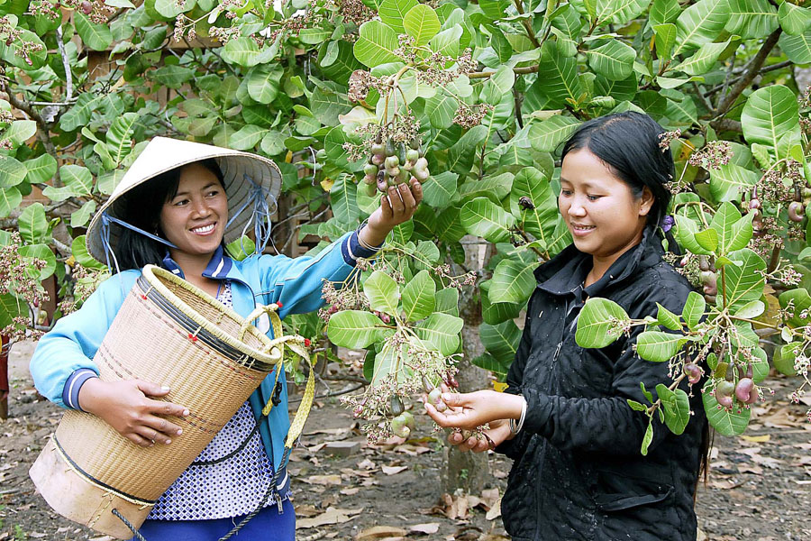
VIETNAM – CAMBODIA CASHEW SEASON IS COMING

Slide 16
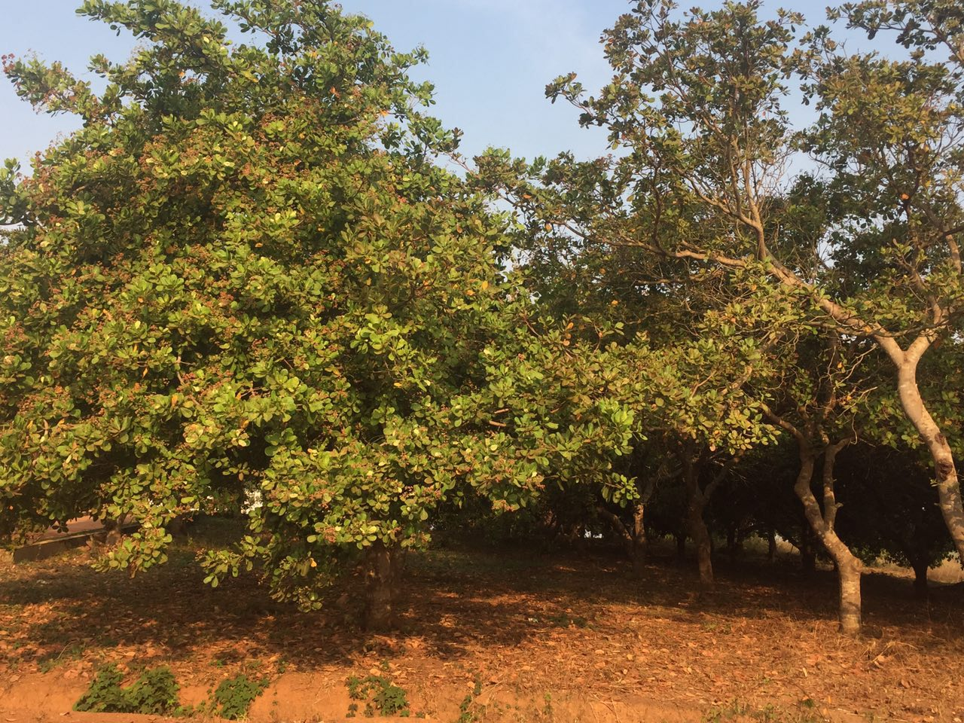
CASHEW TREE IN CAMBODIA – REAL PICTURE

Slide 17
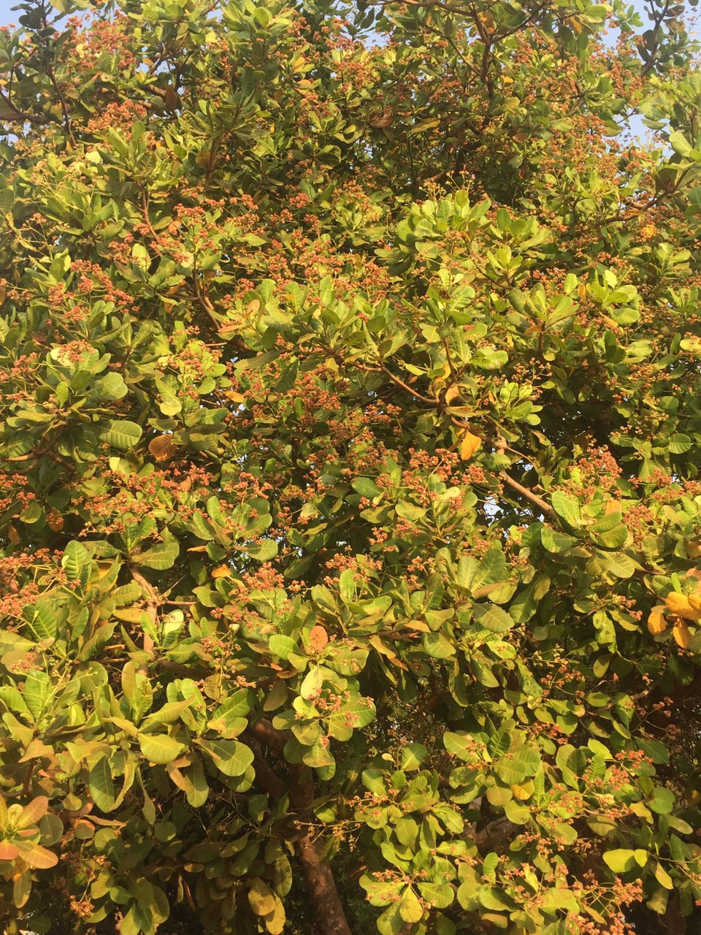
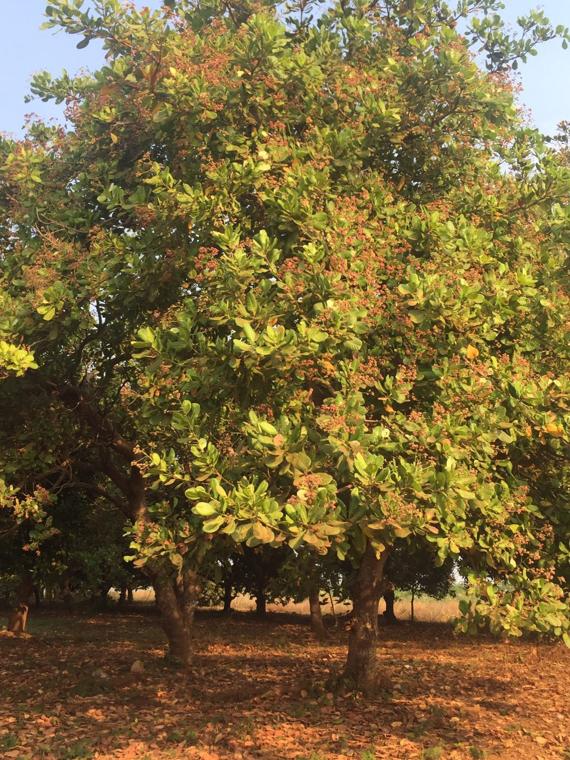
CASHEW TREE IN CAMBODIA – REAL PICTURE

Slide 18
CASHEW TREE IN CAMBODIA – REAL PICTURE

Slide 19
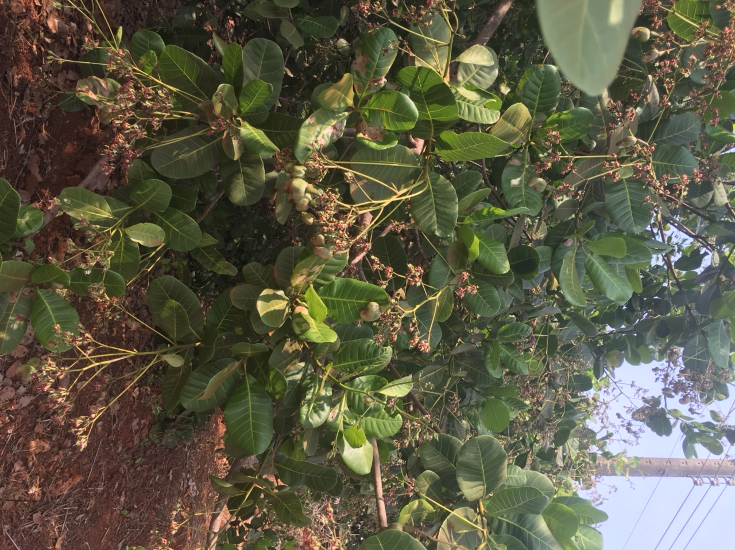
CASHEW TREE IN BINH PHUOC, VIETNAM – REAL PICTURE

Slide 20
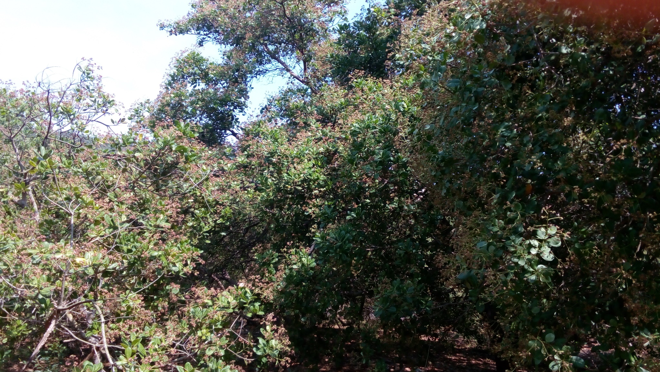
CASHEW TREE IN BINH PHUOC, VIETNAM – REAL PICTURE

Slide 21
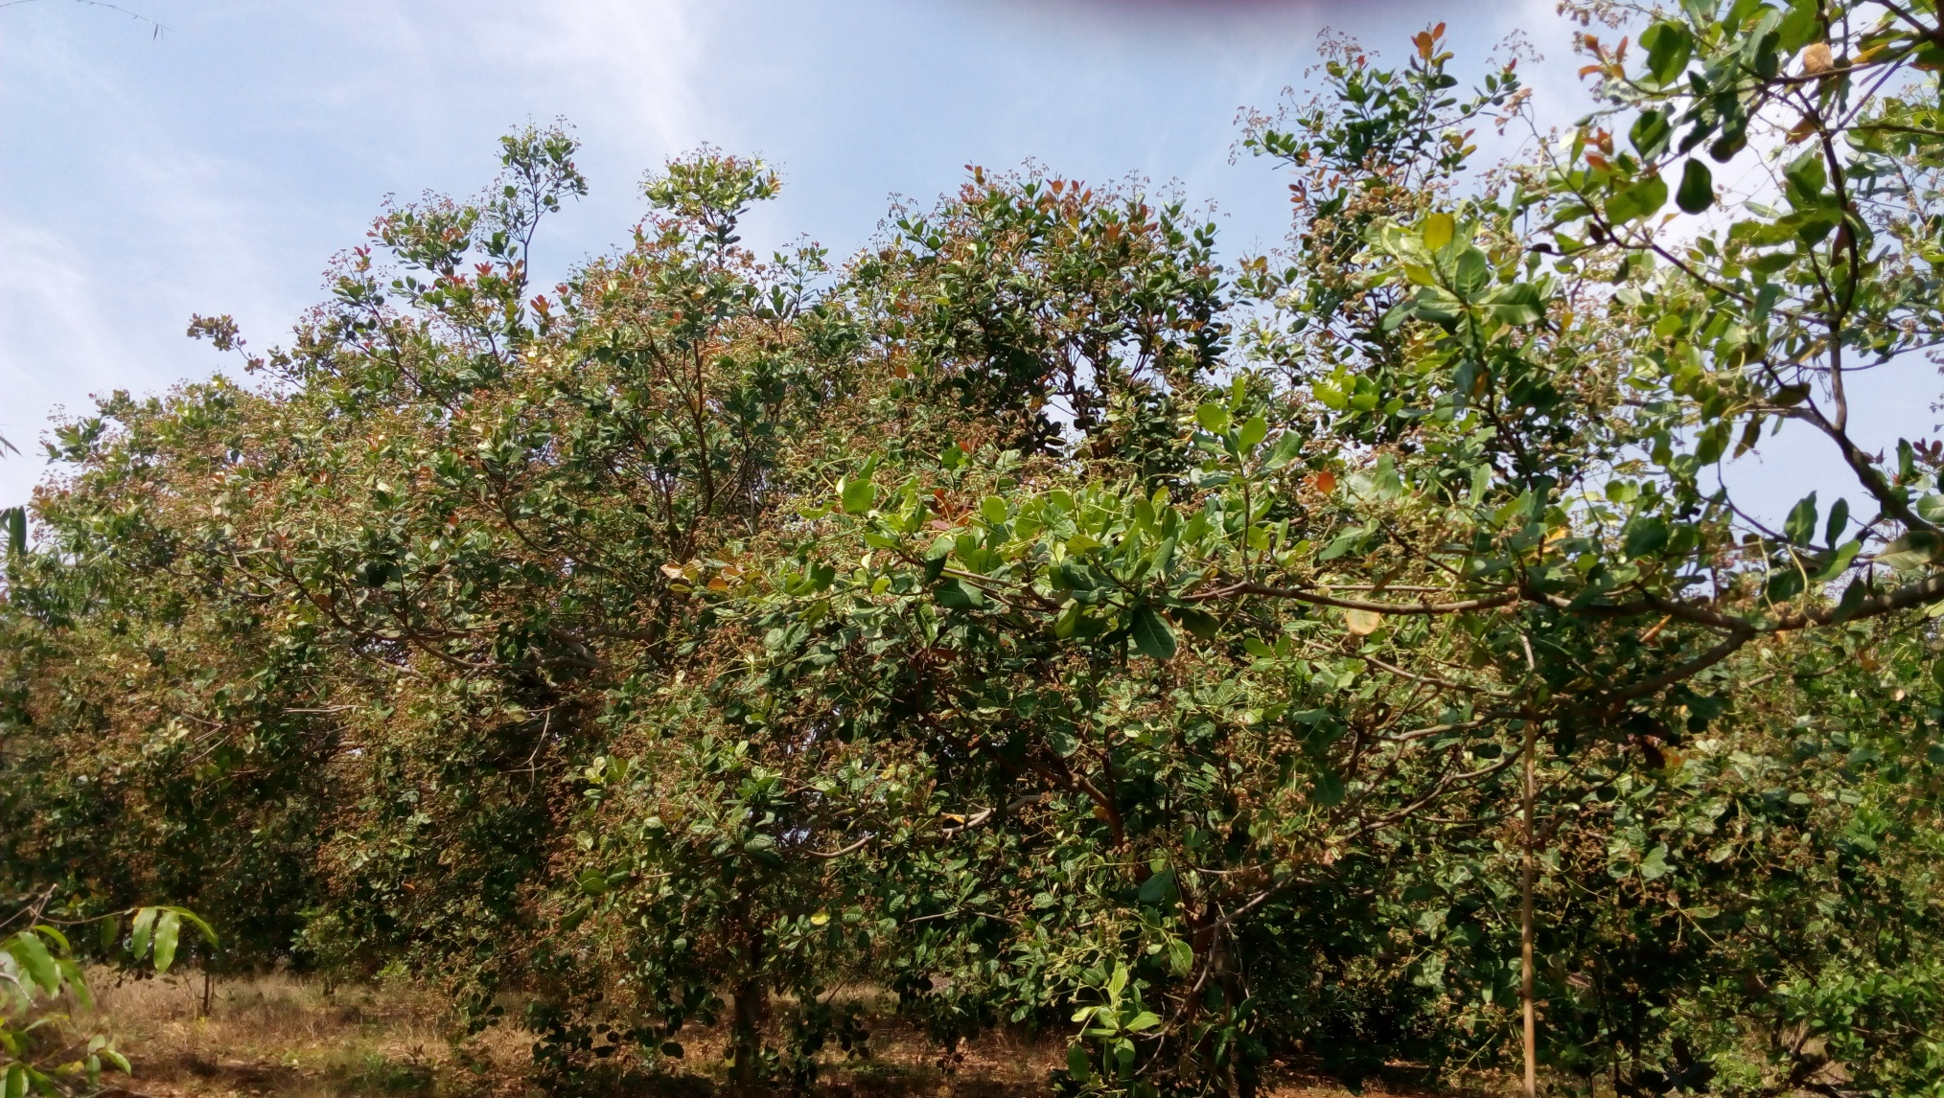
CASHEW TREE IN BINH PHUOC, VIETNAM – REAL PICTURE

Slide 22
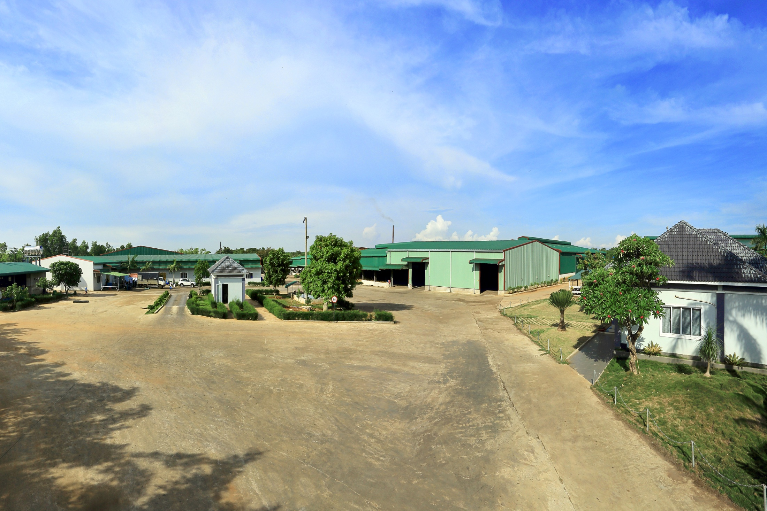
Thank you very much
for your listerning!
CAO PHAT COMPANY LIMITED
 Cashew Processor and Exporter
 Cashew Machinery Manufacturer
Add: 200-202 Binh Gia – Da Bac St, Vinh Binh Village, Binh Gia Hamlet, Chau Duc District, Ba Ria Vung Tau Province, Viet Nam.
Tel: +84.64.3982280 * Fax: +84.64.3982281
Email: director@caophat.com.vn
Website: http://www.caophat.com.vn

